Slide 1

LiDAR-based Canopy Cover prediction
May 3rd Update
Alejandro Donaire Èric Sánchez Pau Ventura

Slide 2

Parallelization (Before)
.
.
.

Slide 3
Parallelization (Before)
.
.
.

Slide 4
Parallelization (Before)
.
.
.

Slide 5
Parallelization (Before)
.
.
.

Slide 6
Parallelization (Now)
.
.
.

Slide 7
Parallelization (Now)
.
.
.

Slide 8
Parallelization: Test idea
Check memory bound problem
Test 1
Test 2
1
1
1
2
1
3

Slide 9
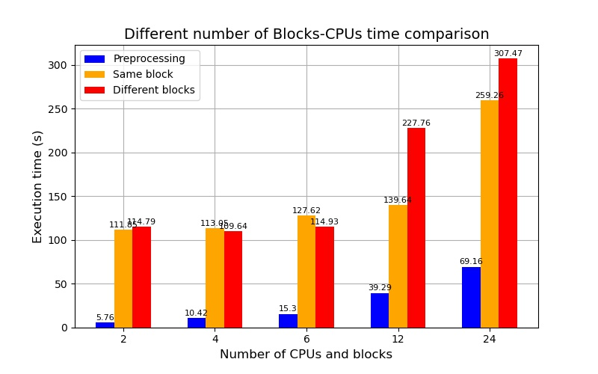
Parallelization - Test results (absolute values)
Sequential processing time for a single block: 70 s.
140s 280s 420s 840s 1680s

Slide 10
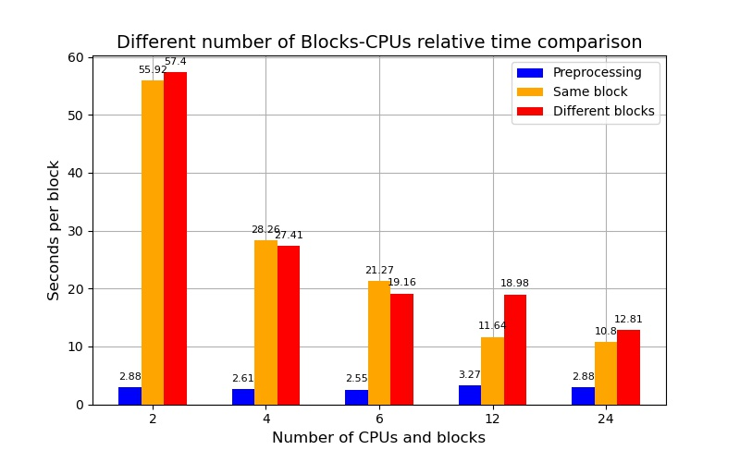
Parallelization - Test results (CPU-relative values)
Sequential processing time for a single block: 70 s.

Slide 11
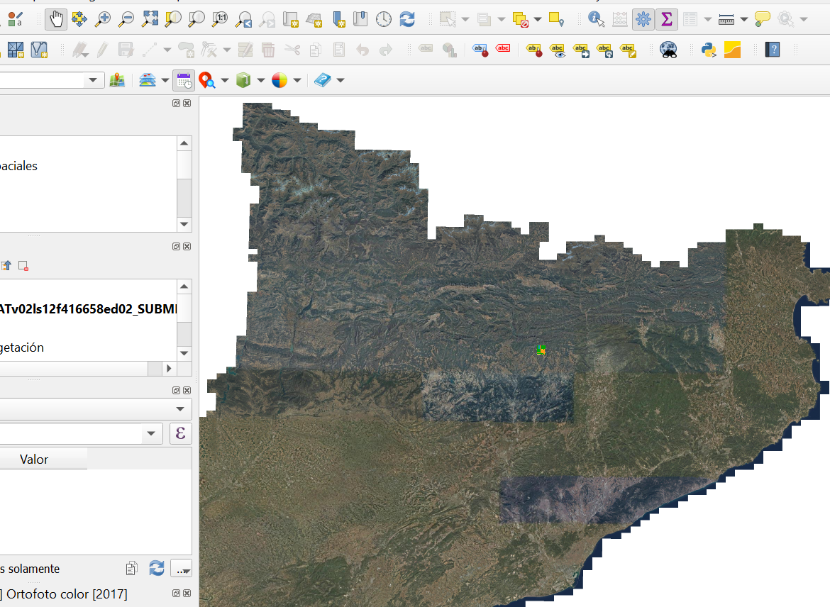
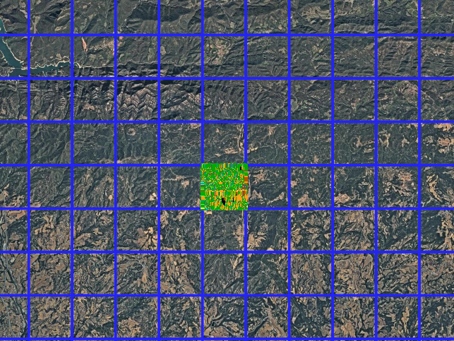
QGIS Plugin Open ICGC
Physical maps with temporal updates, no LiDAR data

Slide 12

Dataset generation optimization
Two new functions:
get_input_dataframe()
get_groundtruth_dataframe()
Not necessary anymore

Slide 13
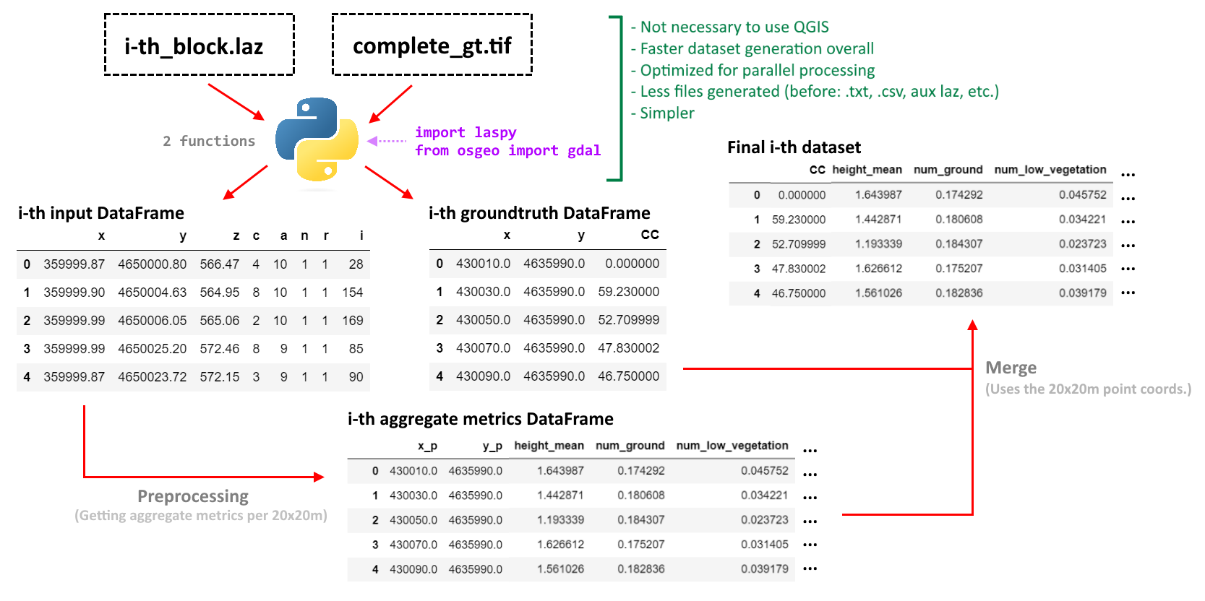
Current dataset generation method overview (single process)

Slide 14
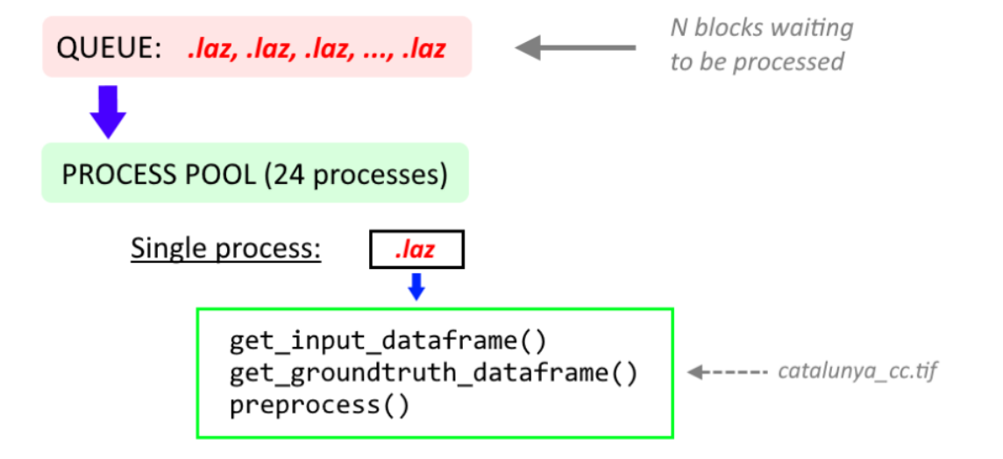
Cluster execution plan - Preprocessing stage

Slide 15
Problems / Research for next week
Resume research for two tendencies with fuel types hypothesis
Hyperparameter search at cluster
Create new and more diverse datasets
Further optimization with pandas

